Slide 1
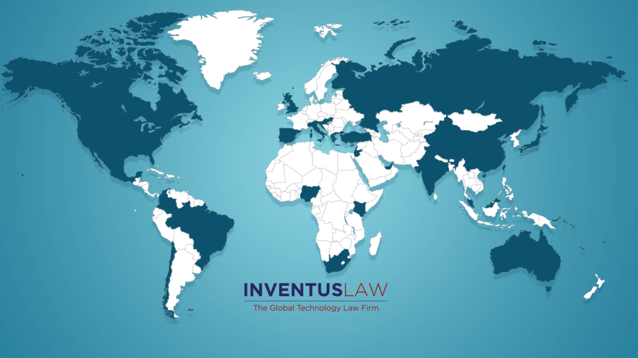
Firm Profile

Slide 2
INVENTUS LAW
THE Global Technology Law Firm.
LEADER in startup law, venture financings, banking, technology law, mergers and acquisitions, commercial transactions, privacy law, patents, trademarks and other intellectual property matters.
OFFICES: headquartered in Silicon Valley, with other offices in San Francisco, San Jose, Palo Alto, Bangalore, Delhi, Gurgaon; global reach and network of investors, mentors and tech companies.
SUCCESSFULLY represented over 3,500 technology companies, with almost 500 financing and M&A transactions totaling over $5 billion.
  EXPANDED client growth with our knowledge of:
  1. Corporate Law, including formations, venture financing and M&A transactions.
  2. Intellectual Property, including patents, trademarks, and copyrights.
  3. Commercial Law Practice, including licensing, customer agreements, partnerships, joint ventures, CFIUS, and privacy and data protection issues under CCPA, GDPR and Indian privacy laws.
31 legal professionals at your service, with over 100 years of combined experience.

Slide 3
OUR EXPERTISE
Commitment to work with founders and startups on navigating through the life-cycle of the startup.
Full-service law firm for high growth technology companies and investors with practice areas including: General Corporate, Venture Financings, Commercial Transactions, GDPR, and Global Privacy Laws.
The Firm has advised clients on more than 1,000 seed, angel and venture capital financings.
The Firm has advised clients on more than 100 mergers and acquisition transactions with deal sizes ranging from $5M to $400M.
Inventus has expertise in media, healthcare and cryptocurrency technology laws and regulations.
The Firm has advised clients on more than 50 venture debt and leasing transactions.
The Firm has a specialized group of lawyers for Patents, Trademarks and Copyright protection.
Our lawyers in the Global Employment Law Practice Group advise clients on employment matters in U.S., India, Europe, Singapore and Australia.

Slide 4
INDIA PRACTICE
Inventus Law is the leading law firm for US - India transactions.
A full-service India practice with offices in Bangalore, Gurgaon and Delhi.
Lawyers at Inventus Law’s India Practice Group have deep expertise and very strong experience in representing over 500 India based companies as they “flip” to Delaware holding structures, including advising on India and US corporate laws, and regulatory and compliance issues.
We also represent many India based venture capital investors on their U.S. investments, including Lightspeed India, Avatar Growth Capital, Sequoia Capital India [Peak XV], Avataar Venture Partners [successor to Norwest India], Ivy Capital, Iron Pillar, Sistema [Russia based].
We have over 15 lawyers that are licensed to practice law in India

Slide 5
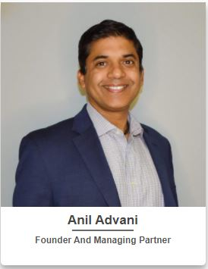
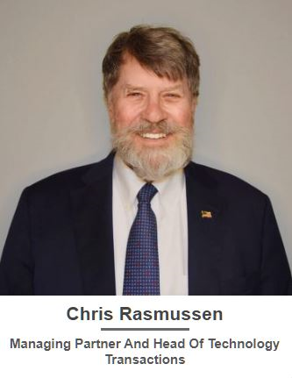
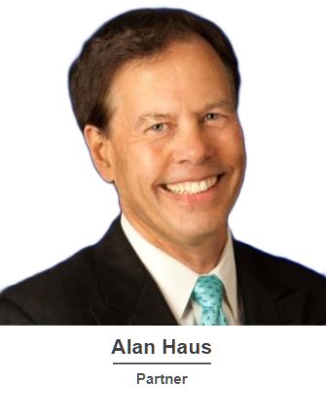
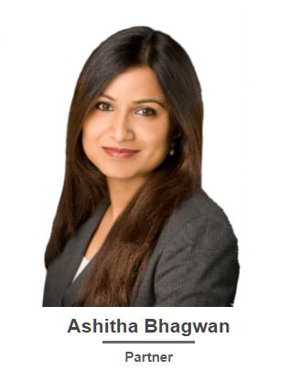
OUR PARTNERS
Anil is a startup lawyer, angel investor, and mentor to early-stage startup founders. Anil has nearly three decades of experience practicing law and is admitted in California, New York, India, and the U.S. Supreme Court.
Anil has represented over 3,500 startups, angels, and founders on hundreds of financing and M&A transactions, with a cumulative worth of over $3.5 billion.
Chris is an experienced corporate attorney with almost 50 years of experience in the telecommunications and technology industry.
Chris’s focus is on start-up and early-stage companies with emphasis on technological and commercial transactions, trademark and privacy policy law.
Alan is a former chair of the California State Bar Trademark Committee, working in the areas of intellectual property, employment, and is outside general counsel to many privately held companies.
Alan’s industry specialties are in consumer products, education, entertainment, software, publishing, video games, and e-commerce.
Ashitha has over a decade of experience representing startups, founders, investors, and funds on aspects related to corporate law, venture capital investment, mergers and acquisitions, international transactions, strategic business alliances, and intellectual property.
Ashitha is a dual law license holder and advises U.S. companies looking to expand into India and Indian companies and entrepreneurs looking to set up or expand their U.S. operations.

Slide 6
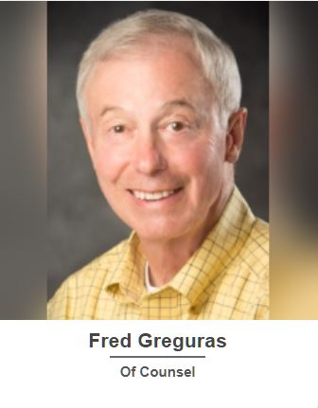
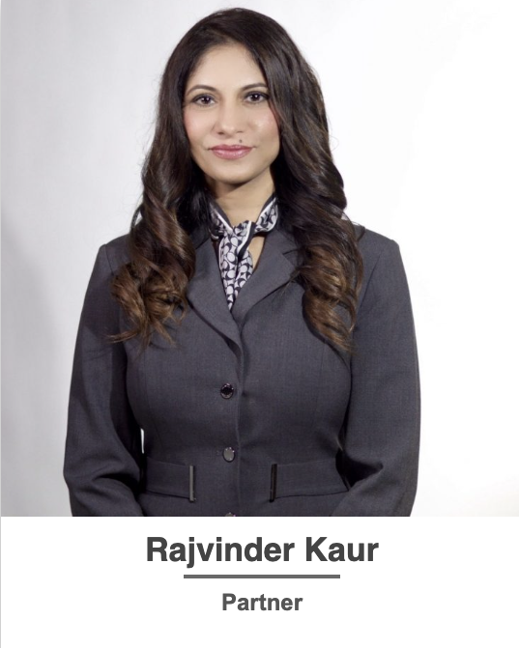
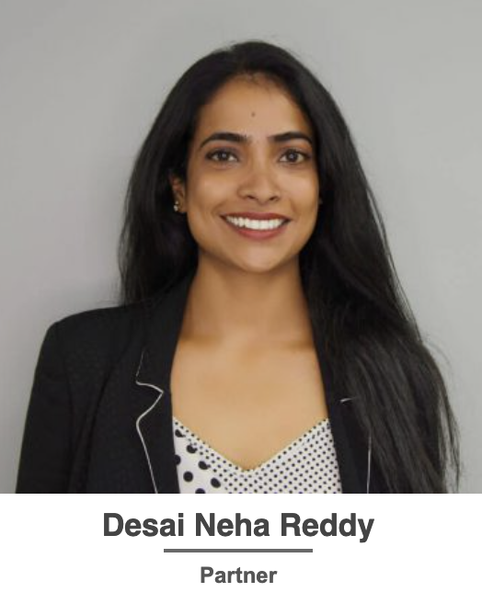
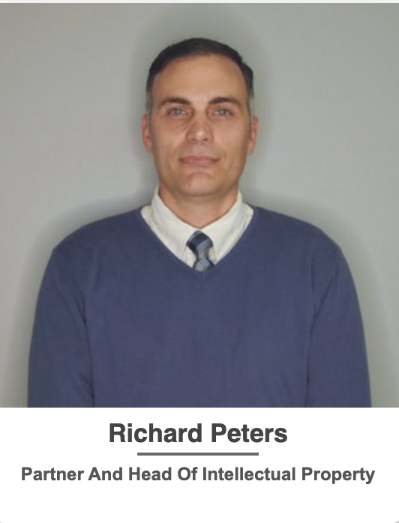
OUR PARTNERS
Fred is an experienced U.S. and international business attorney whose transactional experience for startups includes equity and debt financing, mergers and acquisitions, joint ventures and licensing.
Fred has substantial experience representing companies with a market focus or operations in China, India, Vietnam and other places in Asia, and in representing investors and businesses from those countries.
Rajvinder is a Partner at Inventus Law Practice Group with over 15 years of experience advising emerging technology companies with a focus on general corporate governance, equity financings, debt financings, mergers and acquisitions, and restructuring. She is licensed in Washington State, India and the U.S. Supreme Court. She also focuses on counseling emerging technology companies from India on corporate structuring, employment and general corporate laws of India, and has represented 100’s of founders and investors from India.
Neha is a Partner at Inventus Law Technology Partners and a seasoned lawyer with over 10 years of experience practicing law. She specializes in start-up and venture financings and M & A transactions with a focus on cross-border transactions between U.S. and India. She is licensed in California and India. She holds a prestigious Masters in Law degree from the renowned Stanford Law School, solidifying her expertise and knowledge in the legal field.
Richard has practiced law for 15 years and has extensive experience drafting and prosecuting patent applications in the software, electrical, semiconductor, computer networking and data management fields. In addition, he has written patent applications for a number of large companies including Texas Instruments, VMWare, LSI Logic, NVIDIA and NetApp. Currently Mr. Peters specializes in assisting startups to develop their patent portfolios.

Slide 7

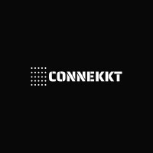
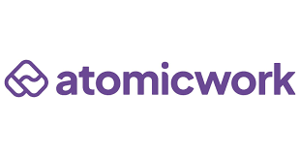

OUR CLIENTS IN THE NEWS
Netradyne, an industry-leading SaaS provider of artificial intelligence (AI) and edge computing, announced the close of a $100 million Series D round led by Point72 Private Investments with participation from Qualcomm Ventures and Pavilion Capital. The capital infusion will accelerate the company’s growth trajectory through strategic investment in R&D, enhanced go-to-market investments, and aggressive global expansion, solidifying Netradyne as a global industry leader in commercial fleet technology.
India-headquartered Connekkt Media has acquired heavyweight marketing agency Mob Scene, the creative force behind campaigns for tentpoles including “A Complete Unknown,” “Dune: Part Two,” “Avatar: Way of Water” and “Barbie.”
The deal positions Connekkt Media, which has outposts in the U.S. and U.A.E., to expand Mob Scene’s creative marketing capabilities into new territories including the U.K., Europe, Middle East India and Asia.
Atomicwork, a leading innovator in agentic service management solutions for Enterprise IT, announced that it has raised $25 million in their Series A funding round. The round was led by Khosla Ventures and Z47, with participation from Battery Ventures, Blume Ventures, and Peak XV Partners. This new infusion of capital accelerates Atomicwork's mission to transform IT service management (ITSM) with its innovative AI-native platform that modernizes how businesses operate and drive growth.
Pixxel is a US-India-based space technology company building the world's highest-resolution hyperspectral satellite constellation, announced the closing of $24 Million in additional funding as part of its Series B round. This new investment brings the total Series B funding to $60 Million. With this, Pixxel has raised a total of $95 Million across all funding rounds to date.

Slide 8


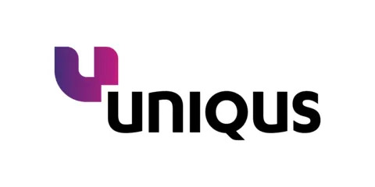

OUR CLIENTS IN THE NEWS
With $4M in seed funding led by Together Fund, with participation from 8vc, Thesys is set to revolutionize AI-driven interfaces by providing a platform that empowers businesses to ideate, visualize and ship intelligent interfaces that adapt to user needs in real time.
Entri App is India's rapidly growing e-learning platform with 10M+ users.
Entri has raised a total funding of $13.9M over 9 rounds.
Uniqus Consultech, a tech-enabled global platform that offers ESG and Accounting & Reporting Consulting, announced that it has raised $30 million in funding. The round was led by Nexus Ventures with participation from Sorin Investments.
Apica, the Sweden-based leader in synthetic monitoring and observability, announced its agreement to acquire Inventus Law client, observability data fabric startup, LOGIQ.AI. With this acquisition, Inventus continues to advise Apica on all its US corporate and commercial matters.

Slide 9

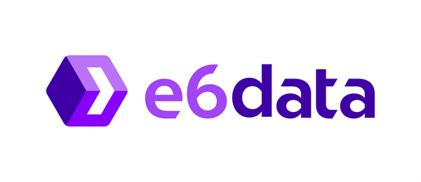


OUR CLIENTS IN THE NEWS
TrueFoundry has raised $19 million in Series A funding, led by Intel Capital, with participation from existing investors Peak XV(formerly Sequoia India) and Eniac Ventures.
.
Neysa, a pioneering AI Acceleration Cloud System provider, announced it has raised $30 million in Series A funding. The round was co-led by existing investors NTTVC, Z47 (fka Matrix Partners India) and Nexus Venture Partners. This investment builds on Neysa’s successful $20 million seed round, underscoring strong investor confidence in the company’s mission to accelerate Gen AI innovation, for Indian enterprises and public sector
Cashfree, an Indian payments startup that facilitates and processes more than $80 billion for its customers each year, has raised nearly $100 million to date.
e6data raised $10million to dismantle lock-in from data intelligence vendors on analytics and AI by halving costs and increasing performance 5x.

Slide 10




OUR CLIENTS IN THE NEWS
Timely secured $14 million in what proved to be their quickest funding round to-date.
Ecolibrium plants $5 million to cut energy consumption in the UK. The green tech startup offers sustainability solutions to enable businesses in commercial and industrial real estate to reduce energy consumption and ultimately achieve their net-zero carbon ambitions.
TrueLark has raised a total funding of $5.95M over 3 rounds. Its first funding round was on June 28, 2018.
Rupifi has raised $25 million in a new financing round as the Indian startup, which currently provides buy now, pay later service to several marketplaces to serve their merchants, looks to expand its business-to-business payments offerings.
Tiger Global and Bessemer Venture Partners co-led the two-year-old startup’s $25 million financing round

Slide 11




OUR CLIENTS IN THE NEWS
Cloud kitchen Salad Days has raised ₹30 crore in Series A funding round co-led by V3 Ventures and Client Associates Alternate Fund (CAAF) in its maiden funding round.
This marks the company's first institutional funding round after operating as a bootstrapped venture for over 10 years.
Cornerstone, a multi-billion dollar company and the market leader in corporate learning management systems, acquired Inventus Law client, EdCast, for over $350 million.
Inventus Law client, Zeplyn.ai closed a $3million seed funding round led by Leo Capital, with participation from Converge VC and angel investors.
San Francisco-based Dashworks, an AI-powered knowledge management platform, announced that it has raised $9.5 million in seed funding. The round was led by Point72 Ventures, with participation from South Park Commons, Combine Fund, Garuda Ventures, GOAT Capital, Unpopular Ventures, and Starling Ventures.

Slide 12

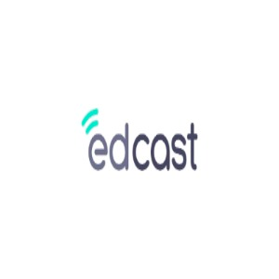

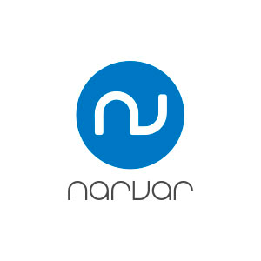
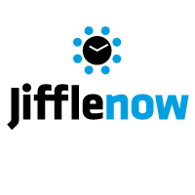




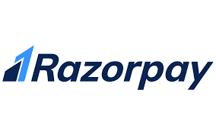



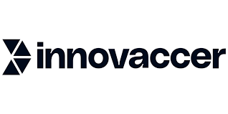


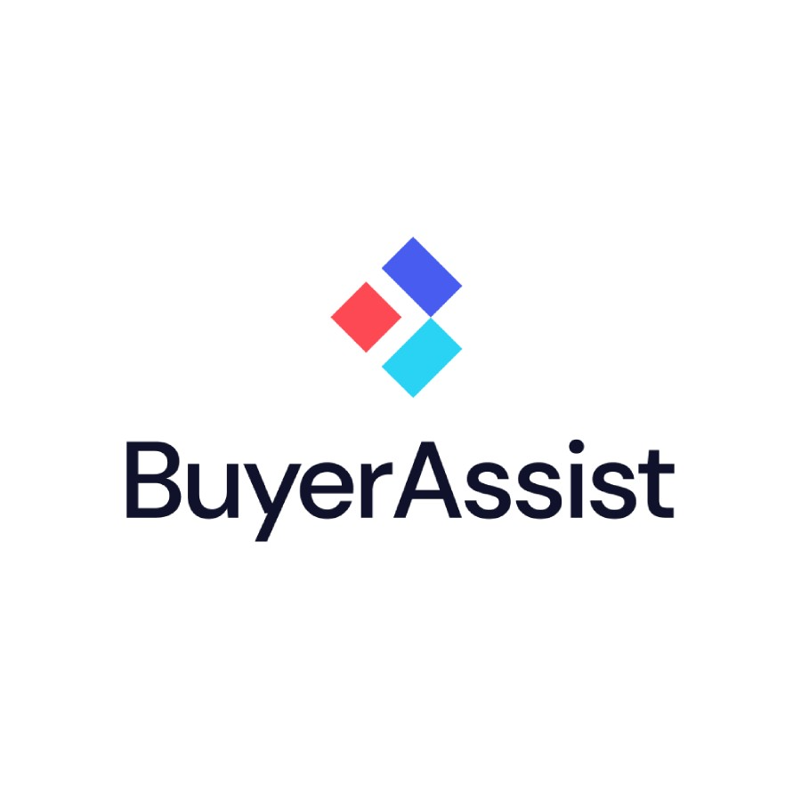










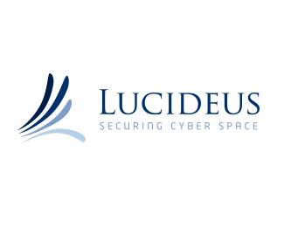


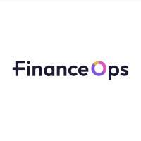
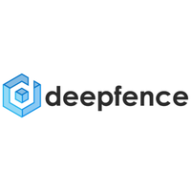




SOME OF OUR CLIENTS

Slide 13
OTHER HIGHLIGHTS
Inventus has represented numerous Venture Capital Firms on their investments in startups in the US, India, Singapore, Turkey and Europe, including Lightspeed India, Elevation Capital, Ivy Cap, Peak XV, Iron Pillar, Avaana Capital, Stellaris Ventures, Bold Cap, Goodwater Capital, and Menlo.
We have advised more than 15 companies in the last 18 months on structuring their Cayman holding structures in order to raise investments from Global investors and building global businesses in the US, India and Europe.
We have advised 100's of India companies in structuring their "flip" transactions to Delaware holding structures in order to access Global capital markets, and get into YC and other premium global accelerators.
We have advised numerous Africa based companies, primarily from Kenya, Nigeria, Ghana and South Africa, along with startups from Turkey, UK, Germany, Singapore and Australia in structuring their "flip" transactions to Delaware.
Inventus Law created the "put option" structure that allows Indian investors to invest in Indian companies with "parallel rights" in the Delaware holding companies. This has become the most preferred approach for India registered Venture Funds to be able to invest in India-US structures.
Inventus Law advises IIT Startups in the San Francisco Bay Area on its legal matters.
Inventus Law has as affiliated entity, Avatar Advisors, that provides accounting, taxes, global growth and fund-raising strategic advisory services to Inventus Law’s global technology clients.
Inventus Law clients closed over $1Billion in aggregate amount of financing and merger and acquisition transactions in the year 2024.

Slide 14

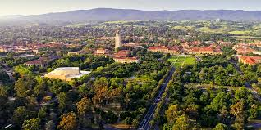



INVENTUS LAW OFFICES
Bengaluru Office
Corporate Office
Corporate Office
Corporate Office
New Delhi Office
355 Bryant Street Suite 403
Stanford Research Park
360 South Baywood Avenue
#21, K.C Das Comfort Building,
Church Street, Ashok Nagar Bengaluru
90/31 B, First Floor,
San Francisco, Ca 94107
3260 Hillview Avenue
San Jose, Ca 95218
Malviya Nagar,
Palo Alto, Ca 94304
New Delhi, South Delhi
560001
Delhi 110017, India

